Slide 1
Summary: Deep Learning time
畅星兆，2019.08.28

Slide 2
Reference

Slide 3
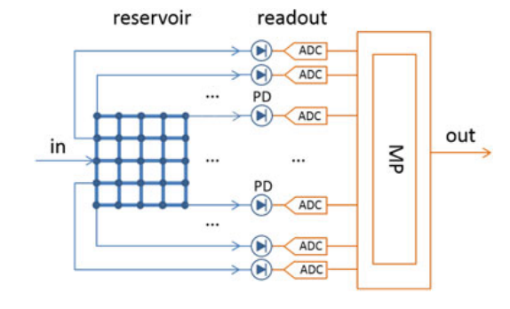
水库计算
强调new paradigm, analog computing,
Readout: machine learning on digital computers.
Micro processor
(Katumba et al., Neuromorphic Computing Based on Silicon Photonics and Reservoir Computing, IEEE Journal of Selected Topics in Quantum Electronics, 2018)
We show how passive reservoir computing chips can be used to perform a variety of tasks (bit level tasks, nonlinear dispersion compensation, etc.) at high speeds and low power consumption.

Slide 4
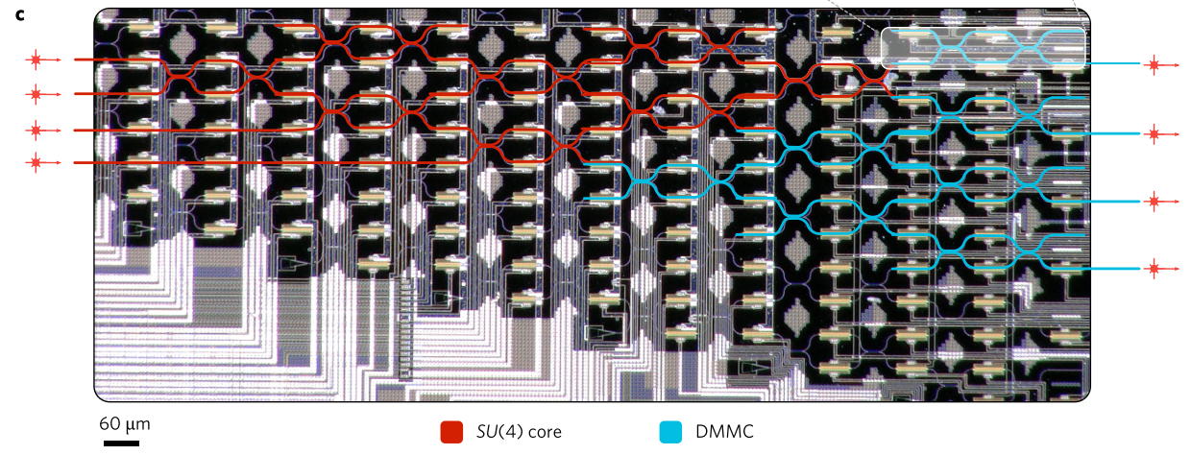
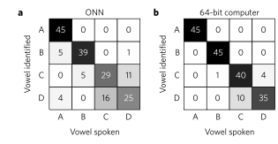
Deep Learning with coherent nanophotonic circuits
(Shen Yichen etal., Deep learning with coherent nanophotonic circuits, Nature Photonics, 2017)
Featuring a cascaded array of 56 programmable Mach-Zehnder interferometers
Power efficiency
Vowel recognition
comparable results
We trained the matrix parameters with the standard back-propagation algorithm using a stochastic gradient descent method on a conventional computer.

